Slide 1

Robotech 2022 AFK
By: Justin Ayiih, Kristian Chappell, Tahsin Nabi
Notes:
All of us

Slide 2
How many phones have you owned?
Notes:
Tahsin

Slide 3
How many do you have right now?
Notes:
Tahsin

Slide 4
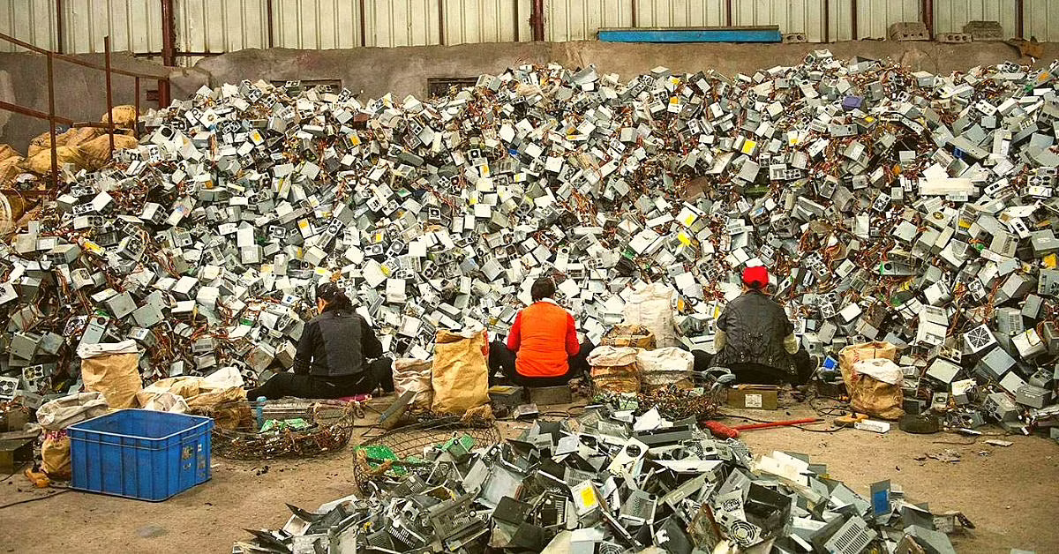
Usable Devices
Notes:
Krisan

Slide 5
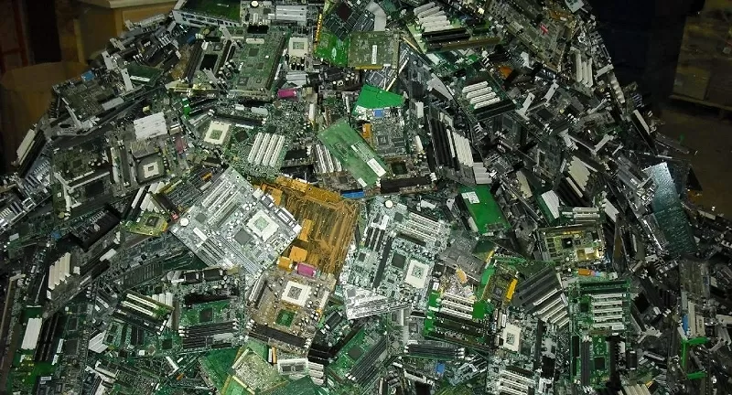
Silicon Waste
Notes:
Kristian

Slide 6


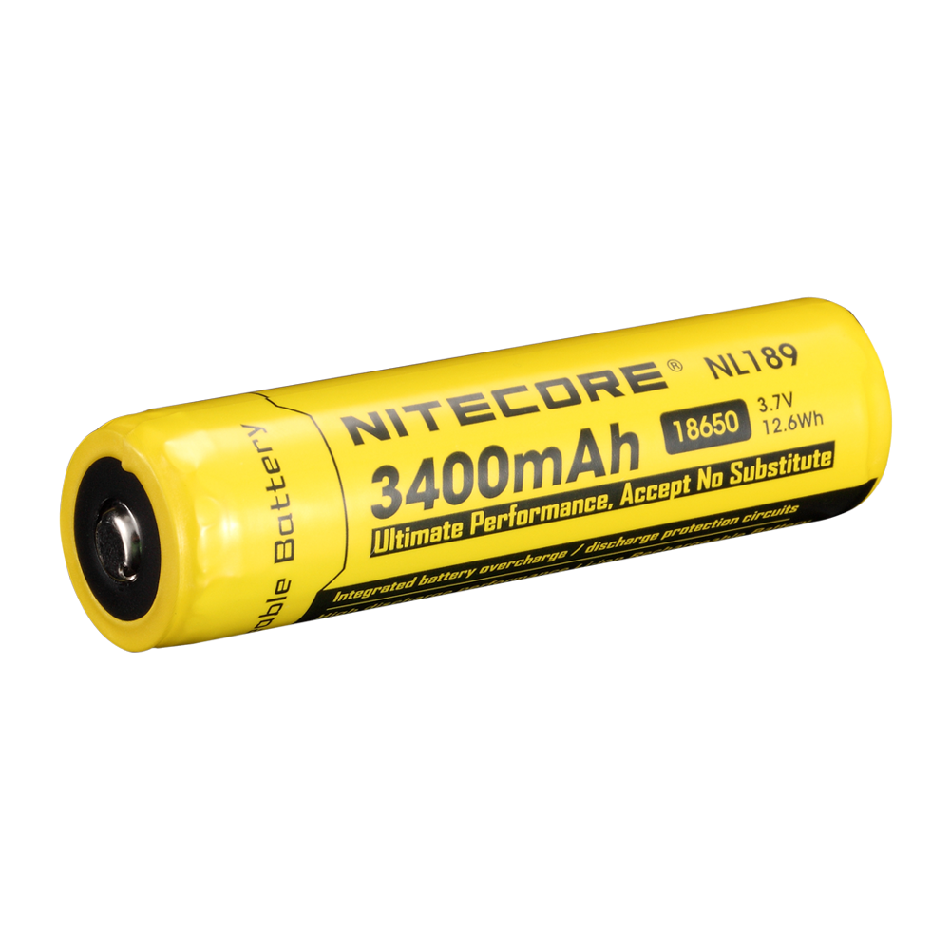
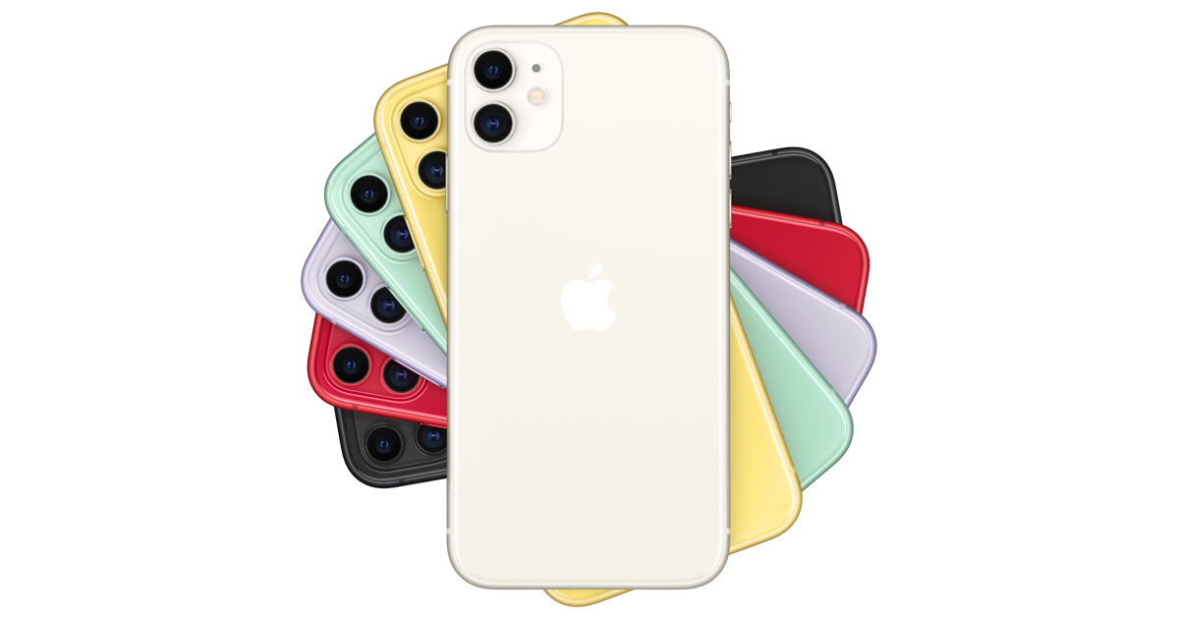
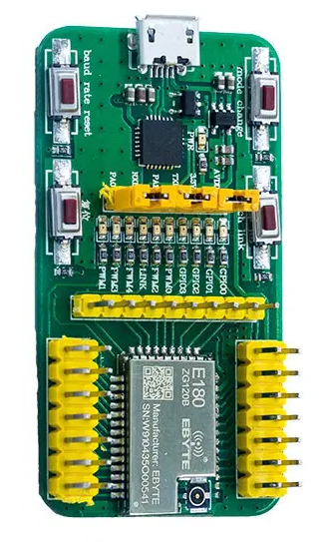
E-Waste
What is E-Waste?
Silicon board and precious metals waste
Battery/hazardous disposal
Much of e-waste is still functional
Why is E-Waste?
Laws which prohibit right to repair
Proprietary and intentionally unrepairable design of electronics
Lack of consumer knowledge
Consumers who choose to buy refurbished do not always know what they are buying and how to fix it
Notes:
Tahsin

Slide 7
Notes:
All of us

Slide 8
Background
Each travel to Bangladesh and take back family and friends old phones and laptops
The phones which would sit in drawers see use instead of being thrown away
I bought a refurbished laptop for school and two parts of the computer failed eventually
When I took apart the laptop I saw that the parts that failed were not from the original manufacturer
If I had known what parts were replaced and more information about the computer, it would have been a better experience
If there was more information about used devices there would be an incentive for consumers to buy refurbished
Notes:
Tahsin

Slide 9
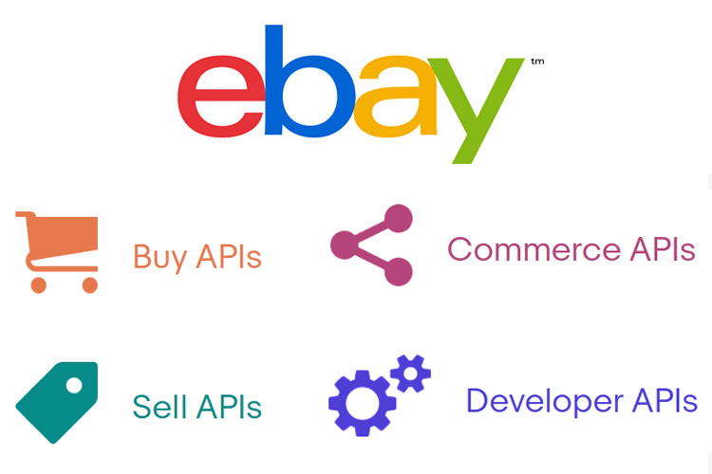


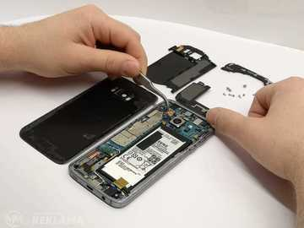
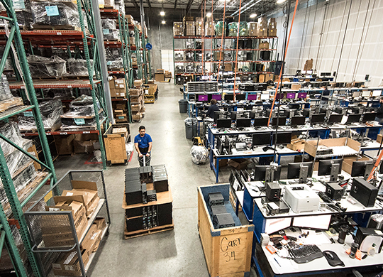
The Concept
Key Features:
Search/Browse/Watching Devices
Contacting Owners
API Integration
Registering Device Repairs
Repair Shops/Verified Sellers
Notes:
Tahsin

Slide 10
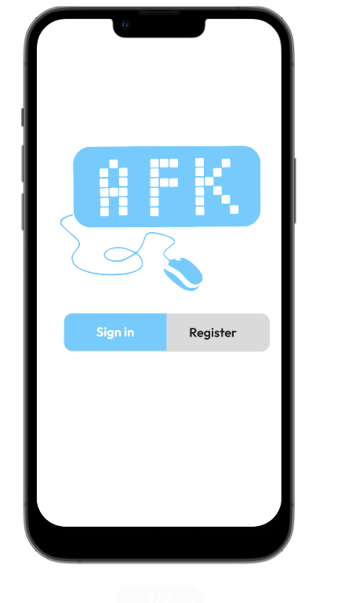
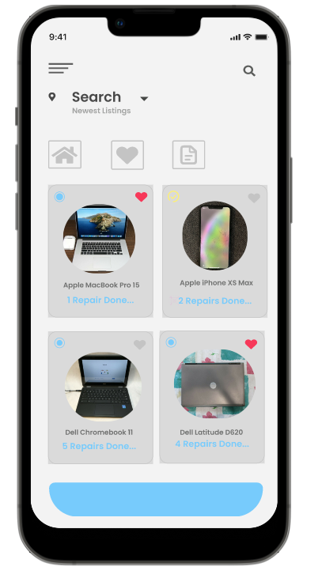
Figure 1: Home Page
Notes:
Kris

Slide 11
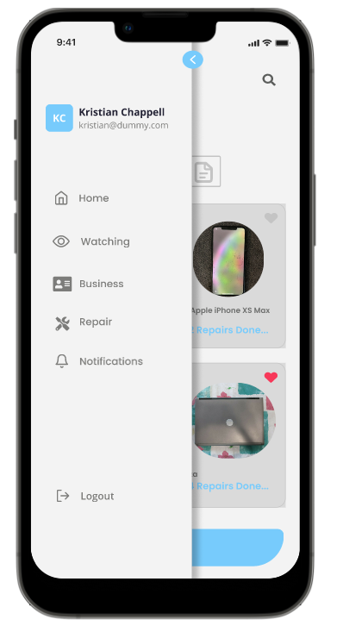
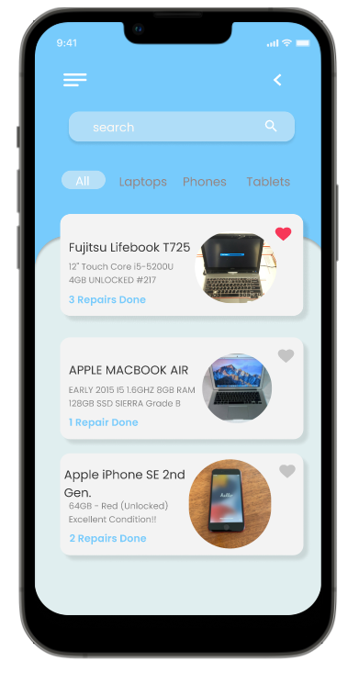
Figure 2: Search/
Browse/Watch Devices
Notes:
Kris

Slide 12
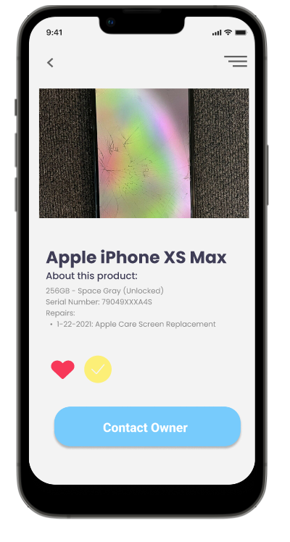
Figure 3: Contact Owner/Repair Shop
Notes:
Kris

Slide 13
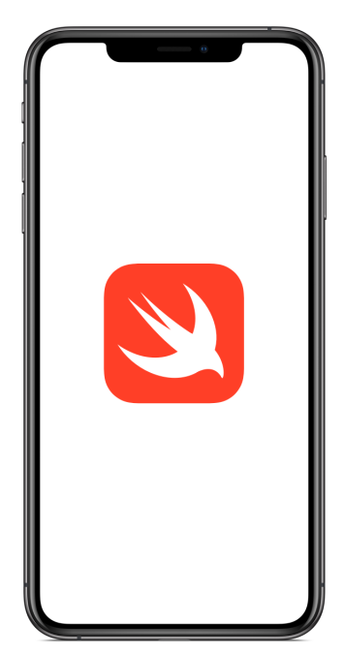


Implementation
Swift for iOS
SQL for the back-end database storage
Javascript, CSS, HTML for the front-end
javascript for a web interface
SQL for the back-end database storage
API’s via eBay and Amazon developer programs
Notes:
Jus

Slide 14


Market Analysis
Potential Customers:
Anyone who owns or is looking to own an electronic device
Estimated 95% of families own a computer in 2022 (IBISWorld)
Free vs. Paid Subscription
Competitors?
Loop Mobile:
Refurbished Apple Products
RefubMe:
Site to buy refurbished devices
Lack history of device
Notes:
Jus

Slide 15

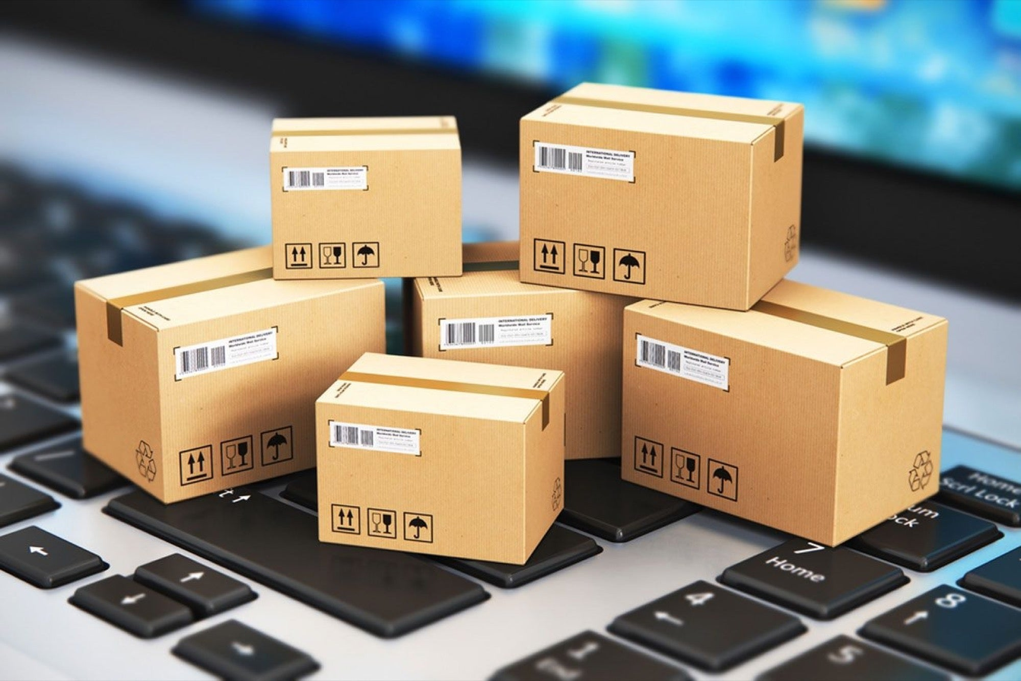
Risk Analysis
E-Waste Market set to grow to reach over $45 billion by 2025.
Tech companies are becoming more supportive of right-to-repair.
Pros:
Keep track of history of device
Provide ways for consumers to fix problem with devices
Can be linked to other sites (eBay, Amazon, etc.)
Repair verifications
Cons:
Does not handle shipping or handling
Does not evaluate value of refushied devices
Notes:
Justin

Slide 16
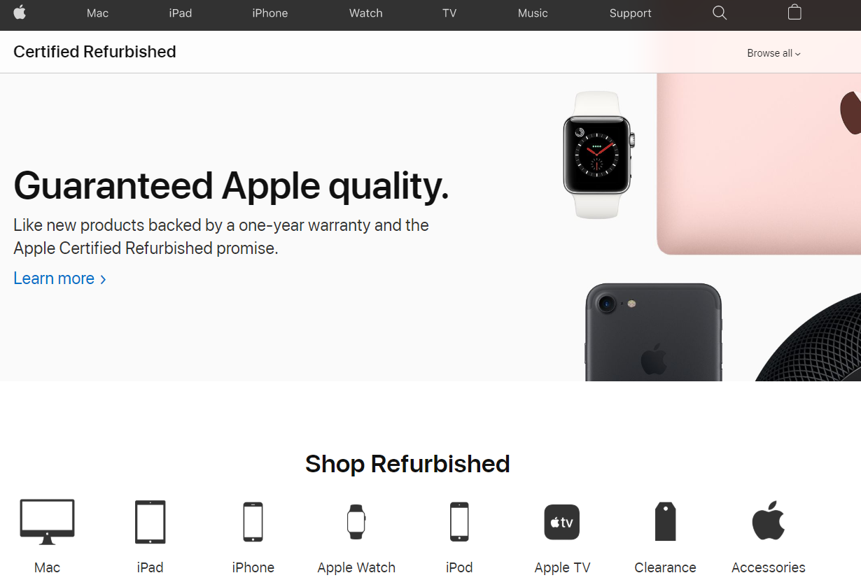
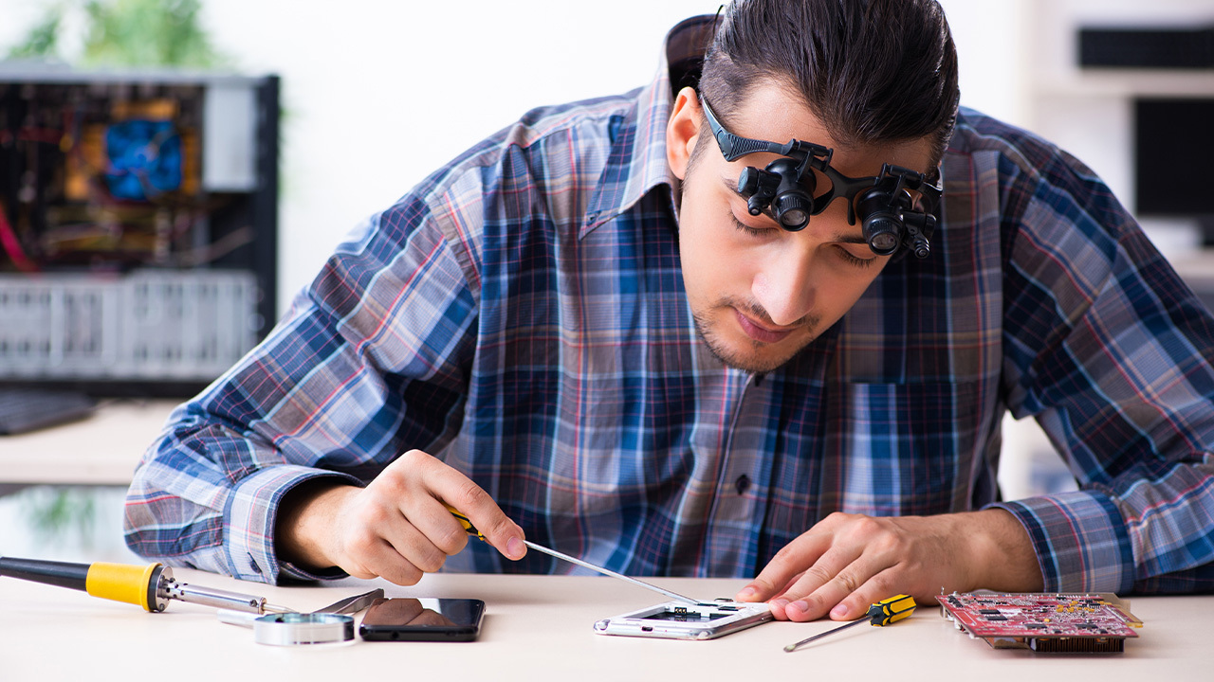
In the future…
We could expand the model/infrastructure to other products
We could try to work with first-party refurbishing centers
Expanded documentation of devices and components
Verification of self-repair
Notes:
Justin

Slide 17
Thank you!
By: Justin Ayiih, Kristian Chappell, Tahsin Nabi
Notes:
Justin

Slide 18
Works Cited
https://www.thebetterindia.com/186938/lifestyle-donate-ewaste-ngo-recycling-old-phones-electronics-india/
https://wraltechwire.com/2022/04/01/right-to-repair-victory-samsung-will-let-galaxy-users-repair-their-own-devices/#:~:text=The%20right%2Dto%2Drepair%20movement,ease%20restrictions%20on%20fixing%20products.
https://my.ibisworld.com/us/en/business-environment-profiles/f311/business-environment-profile
https://www.refurb.me/
https://loop-mobile.com/collections/refurbished-watch
Notes:
Justin

